Slide 1
Confined Space Training

Slide 2
Disclaimer
Confined Space Training
This material was produced under
grant number SH-05073-SH8 from
the Occupational Safety and Health Administration, U.S. Department of Labor.
It does not necessarily reflect the views or policies of the U.S. Department of Labor, nor does mention of trade names, commercial products, or organizations imply endorsement by the U.S. Government.

Slide 3
Welcome
Confined Space Training
What is a Confined Space
When does it become Permit Required?
What are the Hazards
Training

Slide 4
Module-1
Confined Space Training
What is a Confined Space
When does it become Permit Required?
What are the Hazards
Training

Slide 5
What is a Confined Space
According to OSHA
29 CFR 1910.146b
A Confined Space is defined as:
Large enough and so configured that a worker can bodily enter it, and
Has limited or restricted means of entry or exit, and
Is not designated for continuous worker occupancy.
https://www.osha.gov/laws-regs/regulations/standardnumber/1910/1910.146

Slide 6
What is a Confined Space – Part 2
According to OSHA
29 CFR 1910.146b
A confined space is defined as:
Large enough and so configured that a worker can bodily enter it, and
Has limited or restricted means of entry or exit, and
Is not designated for continuous worker occupancy.
https://www.osha.gov/laws-regs/regulations/standardnumber/1910/1910.146
NOTE: What is considered ENTRY?
If you break the plane of a confined space, you have entered the confined space!

Slide 7
Module-1b
Confined Space Training
What is a Confined Space
When does it become Permit Required?
What are the Hazards
Training

Slide 8
When does it become Permit Required?
Permit Required Confined Space has one or more of the following characteristics:
1. Contains or has the potential to contain a hazardous atmosphere;
2. Contains a material that has the potential for engulfing an entrant;
3. Has an internal configuration such that an entrant could be trapped or asphyxiated by inwardly converging walls or by sloped/tapered floors.

Slide 9
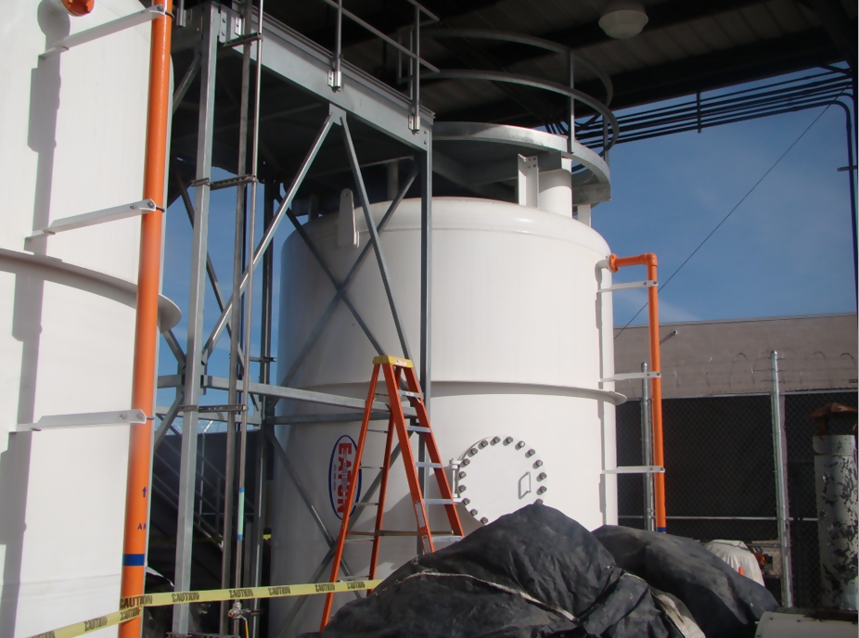
When does it become Permit Required? – Part 2
Example of a
permit-required confined space.

Slide 10
When does it become Permit Required? - Part 3
Permit-required confined space entry
Permit is required whenever there is a hazard
Or potential hazard

Slide 11
Module-3
Confined Space Training
What is a Confined Space
When does it become Permit Required?
What are the Hazards
Training

Slide 12
What are the Hazards?
Potential Hazards in Confined Spaces
Asphyxiating - Oxygen Deficiency
<19.5% or >23.5% oxygen concentration
CO2
CO₂ is toxic in higher concentrations:
1% (10,000 ppm) will make some people feel drowsy.
Concentrations of 7% to 10% cause dizziness, headache, visual and hearing dysfunction, and unconsciousness within a few minutes to an hour.
Toxic Materials
Carbon Monoxide
Hydrogen Sulphide
Welding fumes
Corrosives
Mechanical Hazards
Mixers
Crushers
Engulfment
Soil around an excavation
Grain in a silo
Powdered material in a bin

Slide 13
What are the Hazards? – Part 2
Potential Hazards in Confined Spaces
Electricity
Flammable -Combustibles
Methane
Hydrogen
Acetylene
Propane
Gasoline fumes
Asphyxiating - Oxygen Deficiency
<19.5% or >23.5% oxygen concentration
CO2
CO₂ is toxic in higher concentrations:
1% (10,000 ppm) will make some people feel drowsy.
Concentrations of 7% to 10% cause dizziness, headache, visual and hearing dysfunction, and unconsciousness within a few minutes to an hour.
Toxic Materials
Carbon Monoxide
Hydrogen Sulphide
Welding fumes
Corrosives
Mechanical Hazards
Mixers
Crushers
Engulfment
Soil around an excavation
Grain in a silo
Powdered material in a bin
Oxygen could be removed from the air in a confined space by:
Material in the space could displace the oxygen
Rusting could create a chemical reaction that uses up the oxygen
The space could be purged with a gas to prevent explosions.

Slide 14

What are the Hazards? – Part 3
Gasses

Slide 15
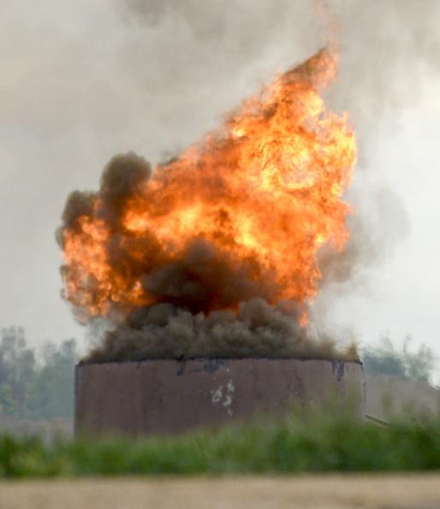
What are the Hazards? – Part 4
Combustibility

Slide 16
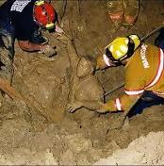
What are the Hazards? – Part 5
Engulfment

Slide 17

What are the Hazards? – Part 6
Mechanical

Slide 18

What are the Hazards? – Part 7
Biological

Slide 19

What are the Hazards? – Part 8
Chemical

Slide 20
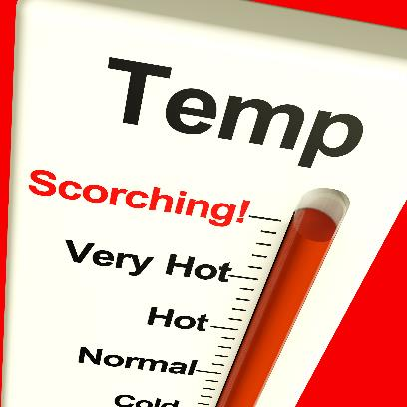
What are the Hazards? – Part 9
Extreme
Temperatures

Slide 21

What are the Hazards? – Part 10
Hazards from
Animals

Slide 22
Module-4
Confined Space Training
What is a Confined Space
When does it become Permit Required?
What are the Hazards
Training

Slide 23
Confined Space Training
OSHA 1910.146(g) Training
The employer shall provide training so that all employees whose work is regulated by this section acquire the understanding, knowledge, and skills necessary for the safe performance of the duties assigned under this section.

Slide 24
Confined Space Training – Part 2
OSHA 1910.146(g) Training
Training shall be provided to each affected employee:
Before the employee is first assigned duties under this section;
Before there is a change in assigned duties;
Whenever there is a change in permit space operations that presents a hazard about which an employee has not previously been trained;
Whenever the employer has reason to believe either that there are deviations from the permit space entry procedures.

Slide 25
Confined Space Training – Part 3
Confined Space Entry
Entry:
The action by which a person passes through an opening into a permit-required confined space; Entry includes ensuing work activities in that space and is considered to have occurred as soon as any part of the entrant’s body breaks the plane of an opening into the space.

Slide 26
Confined Space Training – Part 4
Confined Space Personnel
Authorized Entrant
Enters the confined space
Authorized Attendant
Stands watch outside the entry point of the space
Entry Supervisor
Oversees entry, ensures conformity to permit & acceptable conditions for entry

Slide 27
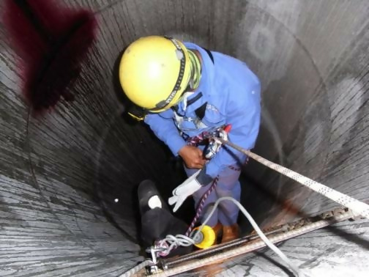
Confined Space Training – Part 5
Confined Space Personnel
Authorized Entrant
The employee who will physically enter the confined space to perform the work.

Slide 28
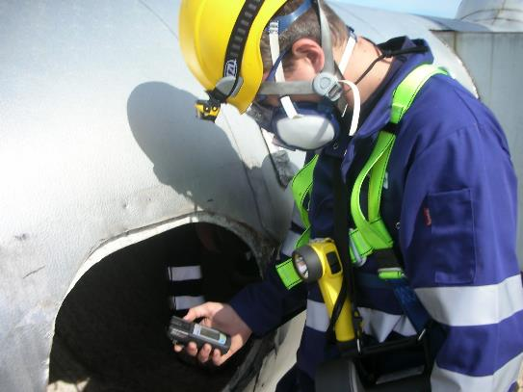
Confined Space Training – Part 6
Confined Space Personnel
Authorized Attendant
The employee who remains outside the confined space and;
monitors the entrant(s)
guards the space against unauthorized entry
warns the entrants of any unusual conditions
and summons the rescue personnel if needed.

Slide 29
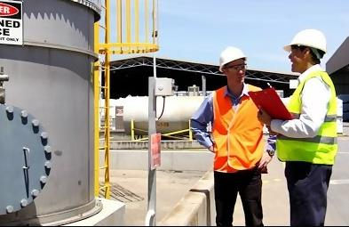
Confined Space Training – Part 7
Confined Space Personnel
Entry Supervisor
The employee who remains outside the confined space and;
warns the entrants of any unusual conditions
Completes Permits,
ensures conformity to permit & acceptable conditions for entry

Slide 30

Confined Space Training – Part 8
Confined Space Permits

Slide 31

Confined Space Training – Part 9
Confined Space Permits

Slide 32
Confined Space Training – Part 10
Confined Space Permits

Slide 33
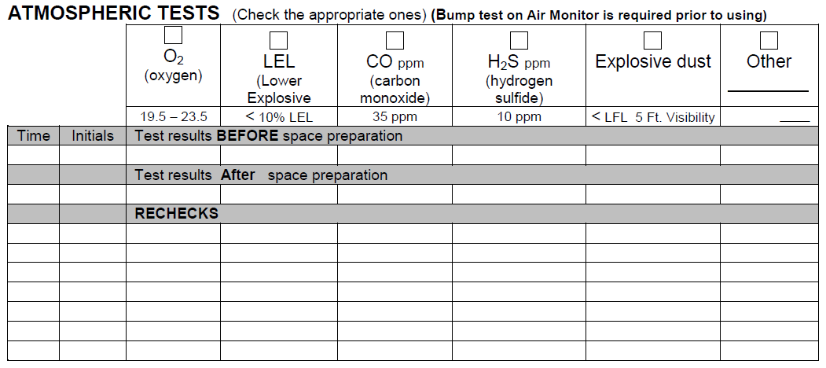
Confined Space Training – Part 11
Confined Space Permits

Slide 34
Confined Space Training – Part 12
Confined Space Permits
Atmosphere Testing Must Be Performed
Prior to every entry when the space is vacant;
After a 10-minute ventilation period (if ventilation is necessary);
At least hourly for permit-required confined spaces. NOTE: A good practice is to re-test the atmosphere after breaks or having been out of the confined space for a period of time.
More frequently, if conditions or suspicions warrant.

Slide 35
Confined Space Training – Part 13
Confined Space Permits
Atmosphere Testing Must Be Performed
Prior to every entry when the space is vacant;
After a 10-minute ventilation period (if ventilation is necessary);
At least hourly for permit-required confined spaces. NOTE: A good practice is to re-test the atmosphere after breaks or having been out of the confined space for a period of time.
More frequently, if conditions or suspicions warrant.

Slide 36
Confined Space Training – Part 14
Evacuation & Rescue
Procedures clearly spelled-out.
Rescue teams made available, Means of contact provided.
Appropriate equipment available; retrieval systems for non-entry rescue; vertical >5 ft.
In-house rescue teams are OPTIONAL!
Dial 911 & notify of confined space emergency, you may attempt retrieval at that point.

Slide 37
Confined Space Training – Part 15
Training: Must Be Certified In Writing
for each affected employee
before first assignment & with changes
deviations from space entry procedures
shall establish employee proficiency

Slide 38

Confined Space Training – Review

Slide 39
Knowledge Check
What is a Confined Space?

Slide 40
Knowledge Check – Part 2
What is a Confined Space?
A Confined Space is defined as:
Large enough and so configured that a worker can bodily enter it, and
Has limited or restricted means of entry or exit, and
Is not designated for continuous worker occupancy.

Slide 41
Knowledge Check – Part 3
2. What is a Permit Required Confined Space?

Slide 42
Knowledge Check – Part 4
2. What is a Permit Required Confined Space?
Permit Required Confined Space has one or more of the following characteristics:
1. Contains or has the potential to contain a hazardous atmosphere;
2. Contains a material that has the potential for engulfing an entrant;
3. Has an internal configuration such that an entrant could be trapped or asphyxiated by inwardly converging walls or by sloped/tapered floors.

Slide 43
Knowledge Check – Part 5
3. Who are the Qualified workers?

Slide 44
Knowledge Check – Part 6
3. Who are the Qualified workers?
The Supervisor – trained, competent, fills in permits, supervises the work & terminates the entry if needed or when completed
The Entrant – trained & authorized to enter. Performs the work.
The Attendant – trained & authorized

Slide 45
Knowledge Check – Part 7
4. What is the primary reason for using a retrieval system for work within a Permit Required Confined Space?

Slide 46
Knowledge Check – Part 8
4. What is the primary reason for using a retrieval system for work within a Permit Required Confined Space?
To allow the attendant to perform a Non-Entry Rescue if problems develop during the entry.
NOTE: Because of the inherent dangers of this work, Only a Trained and Authorized Rescue Team can enter to assist the Entrant (worker)

Slide 47
Additional Resources
OSHA website: http://www.osha.gov and OSHA offices: Call or Write (800-321-OSHA)
Compliance Assistance Specialists in the area offices
National Institute for Occupational Safety and Health (NIOSH) – OSHA’s sister agency
OSHA Training Institute Education Centers
Public libraries

